Slide 1
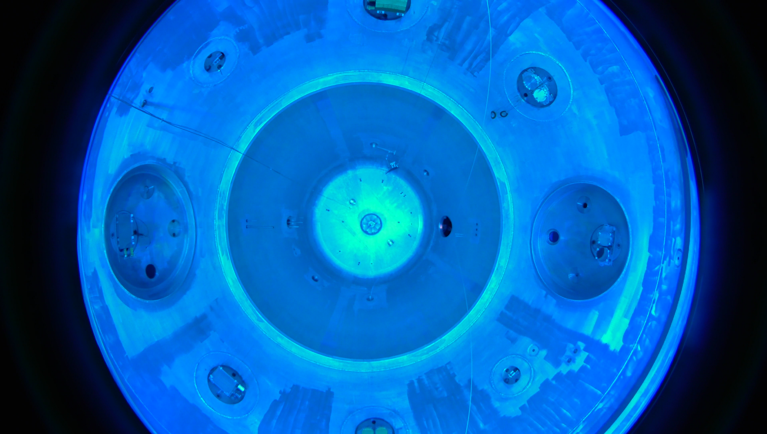
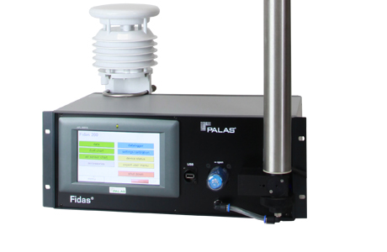
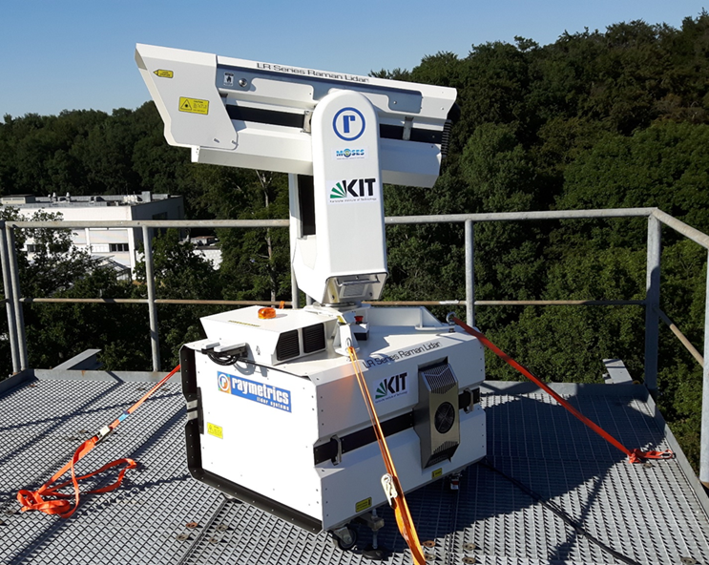
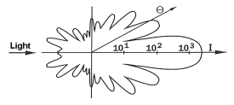
Optical properties calculate from OPC using Mie Theory
Hengheng Zhang, Harald Saathoff, Böhmländer Alexander
https://www.google.com/url?sa=i&url=https%3A%2F%2Fwww.lavision.de%2Fen%2Ftechniques%2Fmie-rayleigh-raman%2F&psig=AOvVaw19NSlbuW4yOhPStg1loLad&ust=1621583206968000&source=images&cd=vfe&ved=0CAIQjRxqFwoTCMjpqqri1_ACFQAAAAAdAAAAABAN

Slide 2
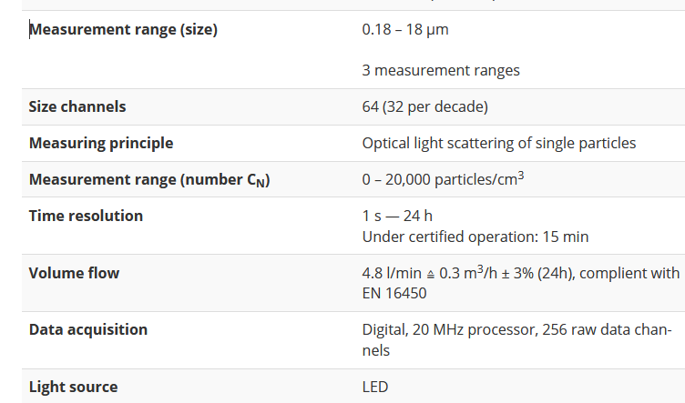
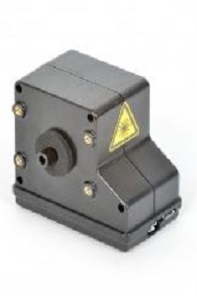
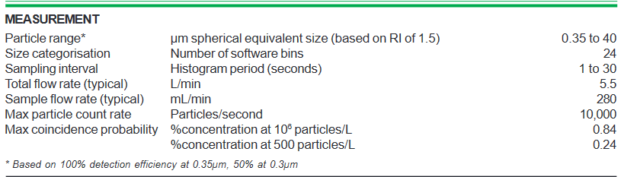
Instruments
Fidas 200
Alphasensor OPC-N3

Slide 3
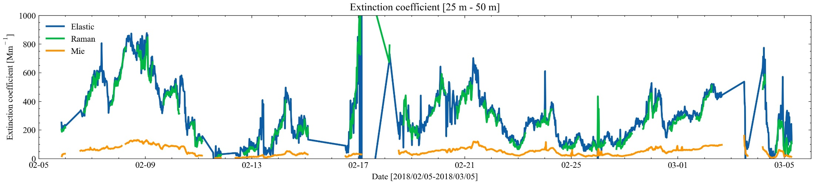
Extinction Coefficient from Mie calculation and LIDAR measurements
Size distribution is measured by Fidas 200.
Extinction coefficients calculated from LIDAR methods (Elastic and Raman) and Mie calculation.
Extinction coefficients calculated from Mie calculation is symmetrically lower than LIDAR measurements.
Potential results ??
a. OPC underestimates the particle size ??
Leinonen, J., Python code for calculating Mie scattering from single- and dual-layered spheres. Available at https://github.com/jleinonen/pymiecoated/.

Slide 4
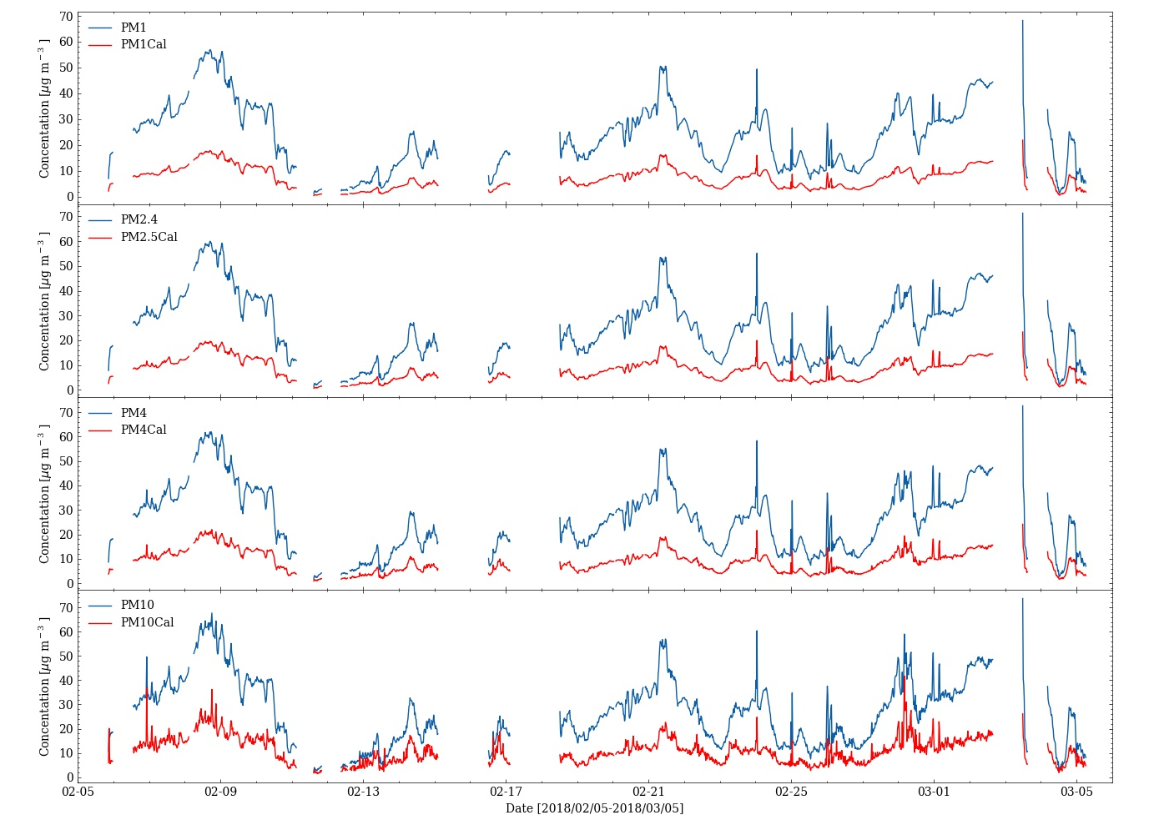
Extinction Coefficient from Mie calculation and LIDAR measurements
Calculated particle matter concentration is also symmetrically lower than software data product.

Slide 5
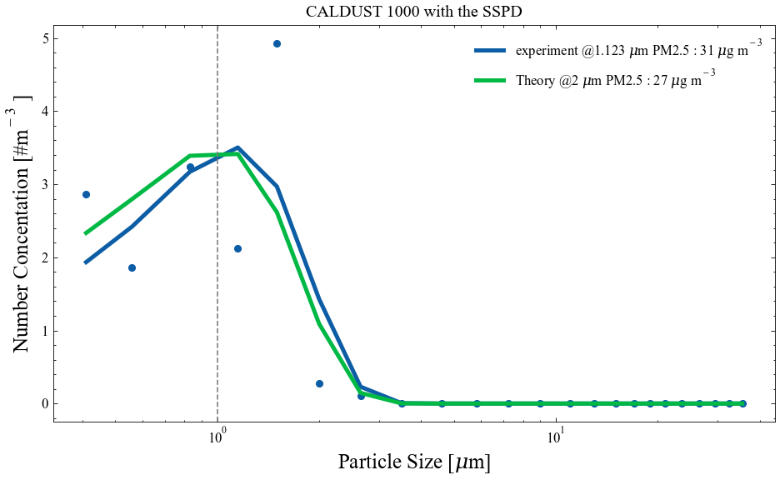
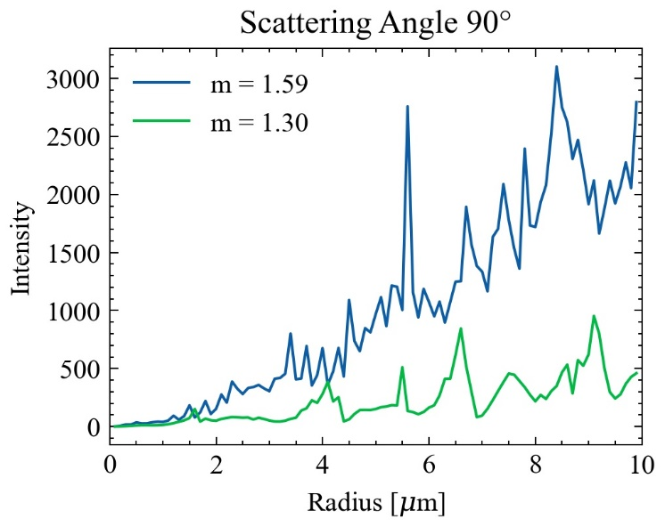
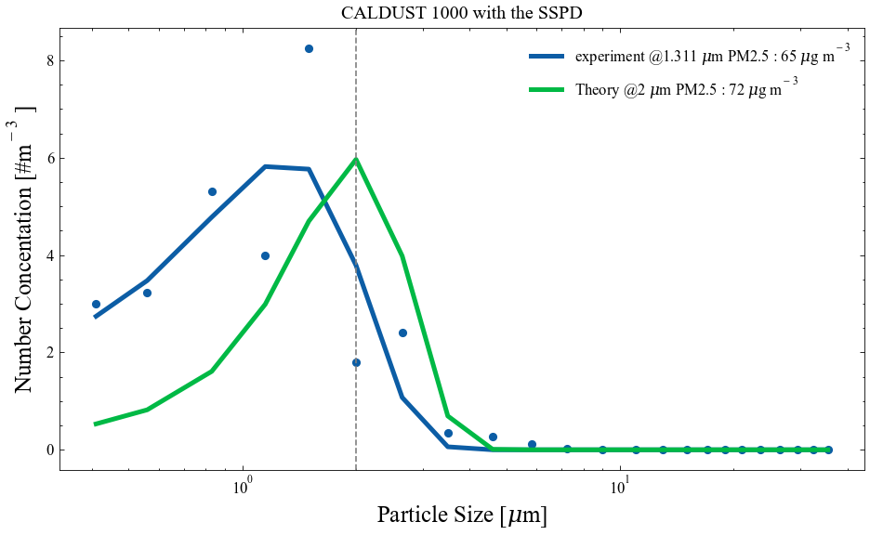
Size calibration in AIDA
Test of alphasense with CALDUST.
The calibration measurement of CALDUST 1000 seems fine
but bring larger uncertainties for CALDUST 2000

Slide 6
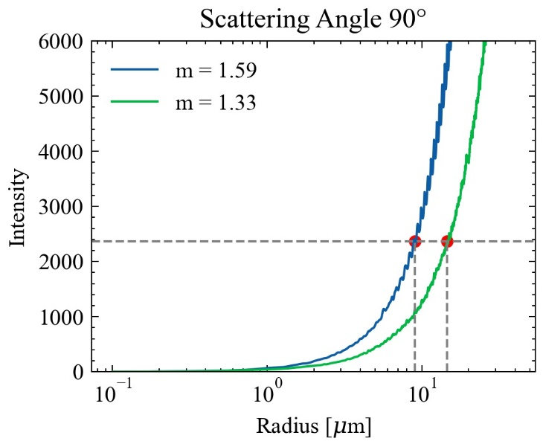
Size calibration of Fidas OPC
Size calibration using mie scattering theory.
I calculated S12 value from 85°-95° using complex reflective index are m = 1.59 + 0i and m = 1.33 + 0i. Then integrate them to get the scatter intensity at side direction.
Scatter intensity = S12[0]²+ S12[1]²
S12 is amplitude scattering matrix

Slide 7
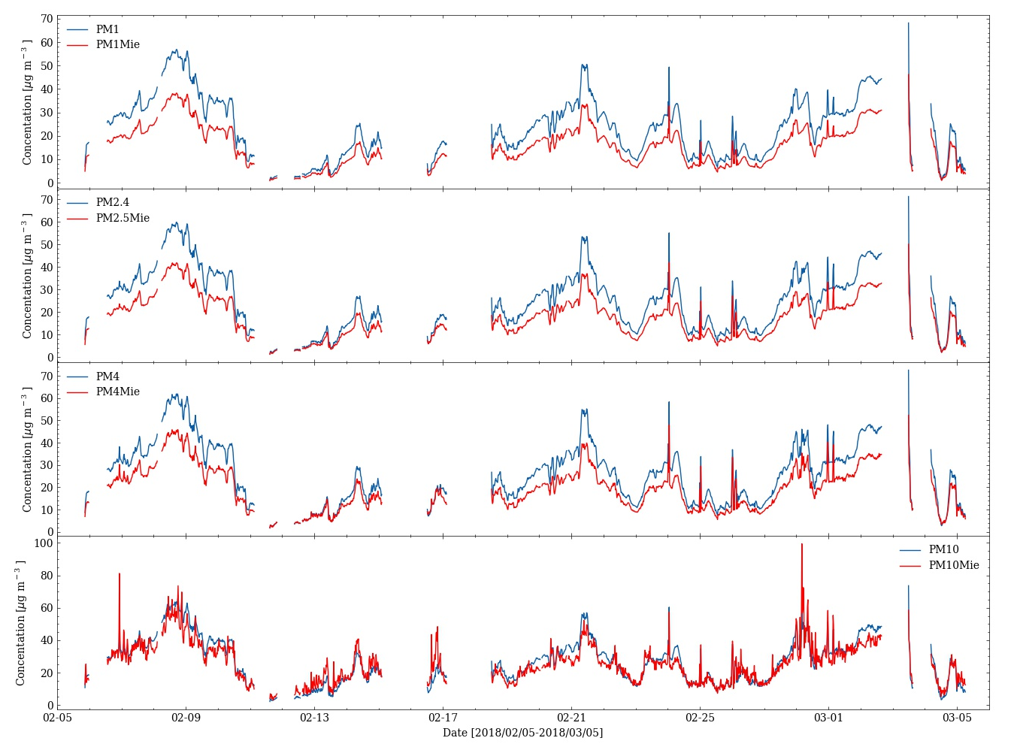
Result after calibration
Both of two methods are match better especially for PM10 measurements.

Slide 8
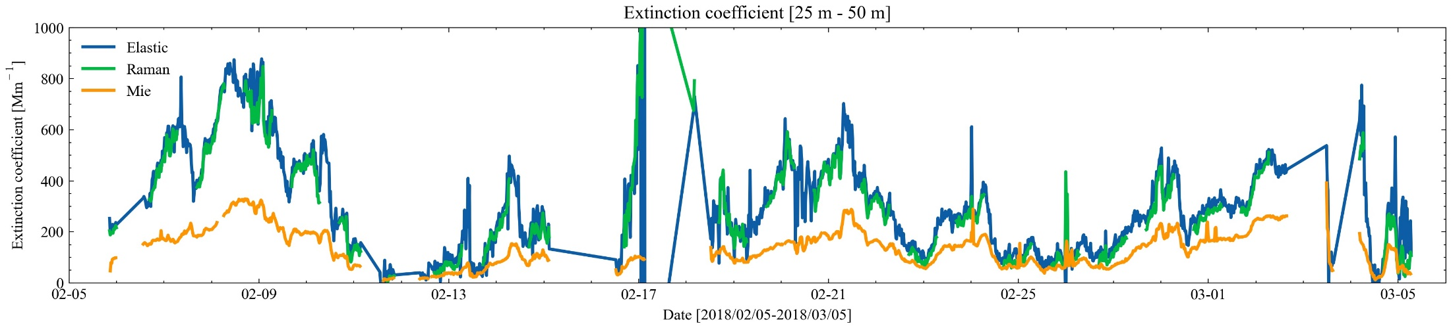
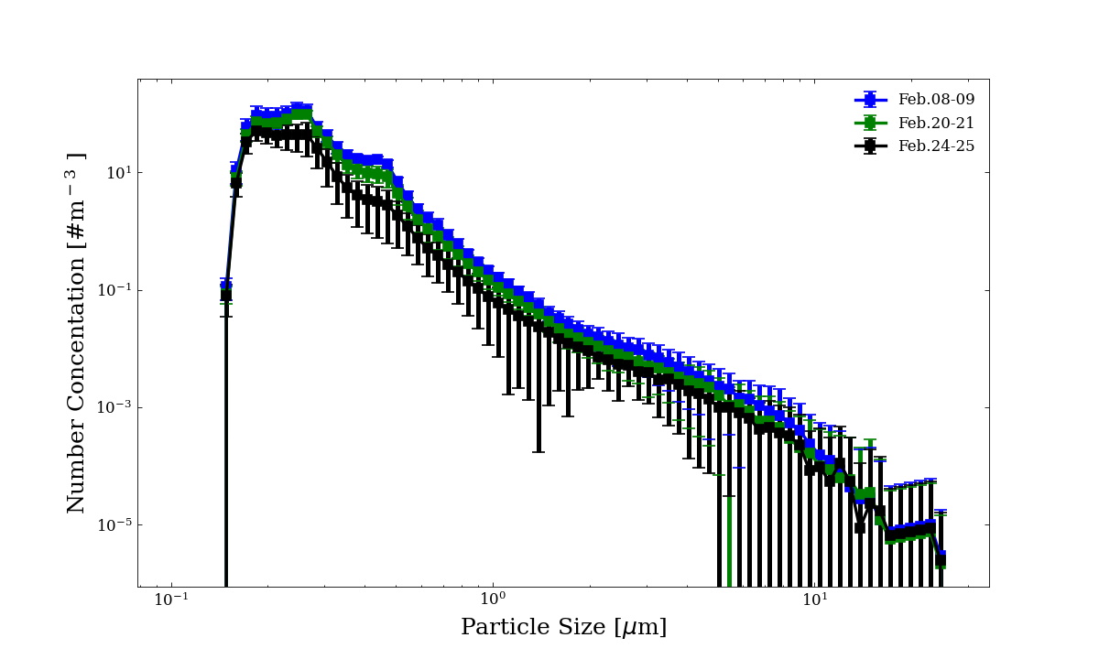
Result after calibration
Although extinction coefficients calculated from Mie is increase but still not match very well.
The size distribution for different periods (Feb.08 – 09 (blue) – match badly, Feb.20 – 21 (green) – fine, Feb.24 – 25 (black) match best).
Bad match is corresponding to a lager concentration at diameter of around 500 nm, which is close to laser wavelength.

Slide 9
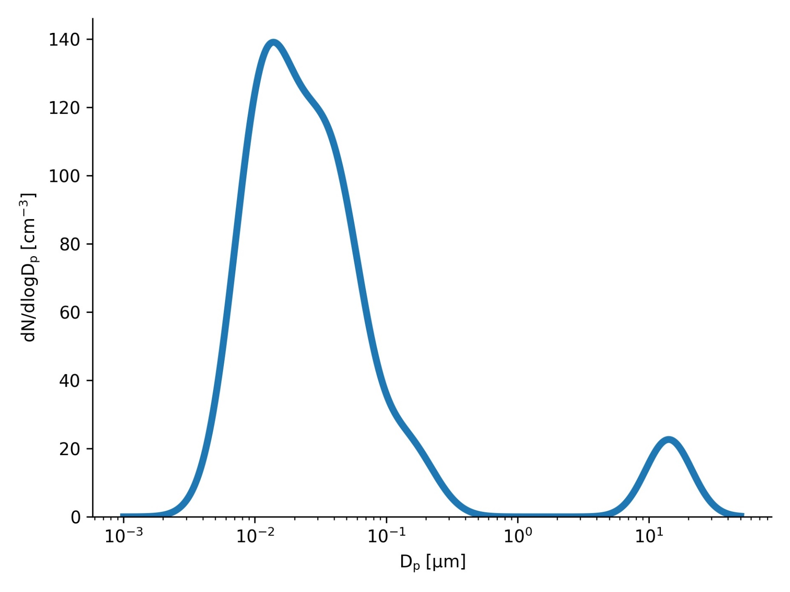
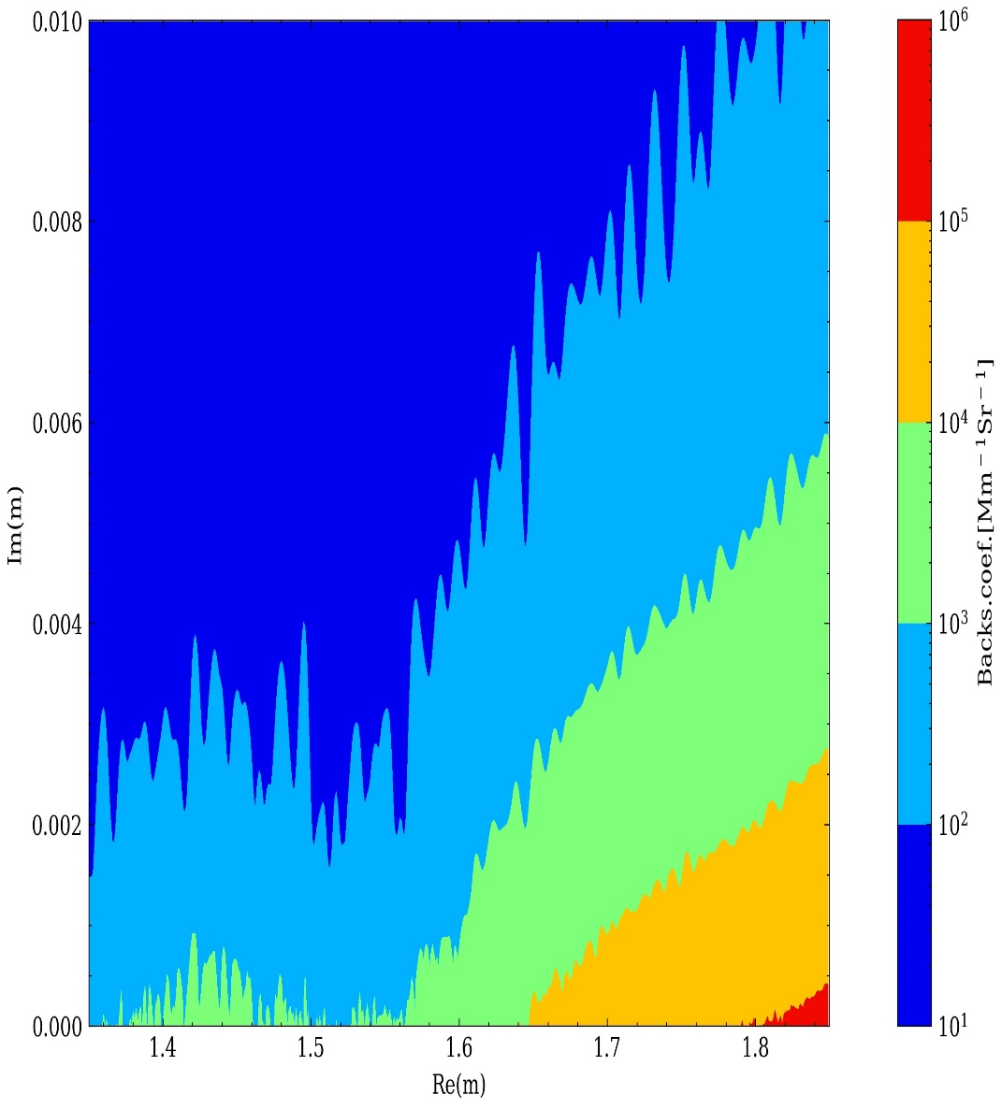
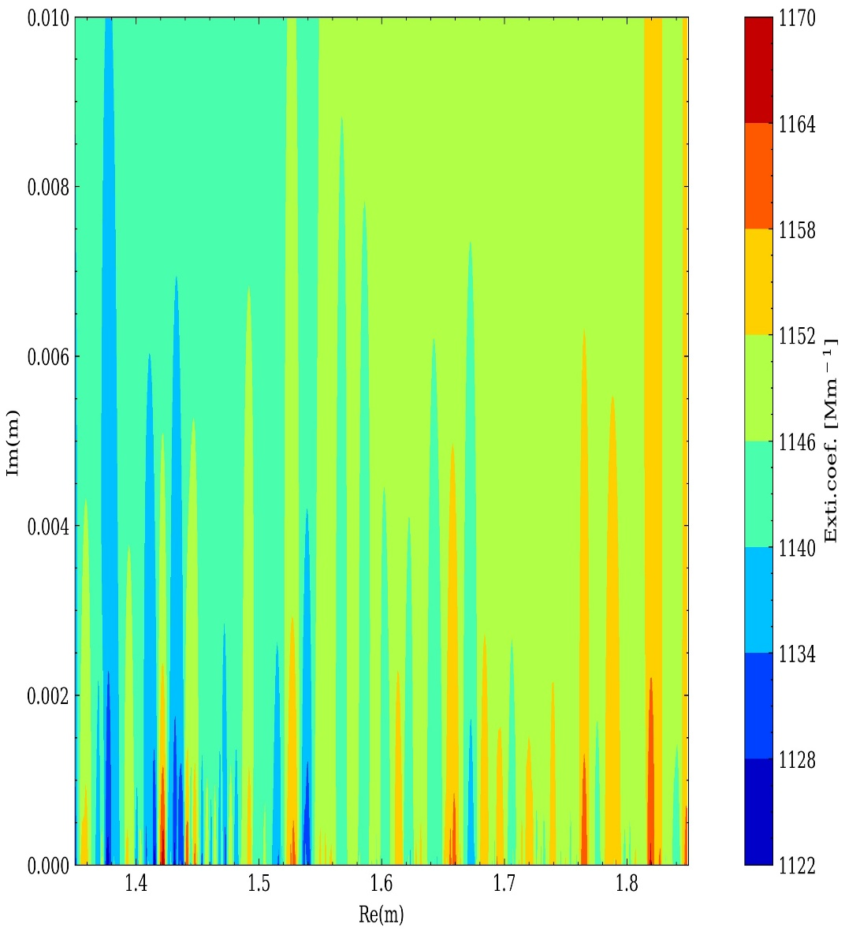
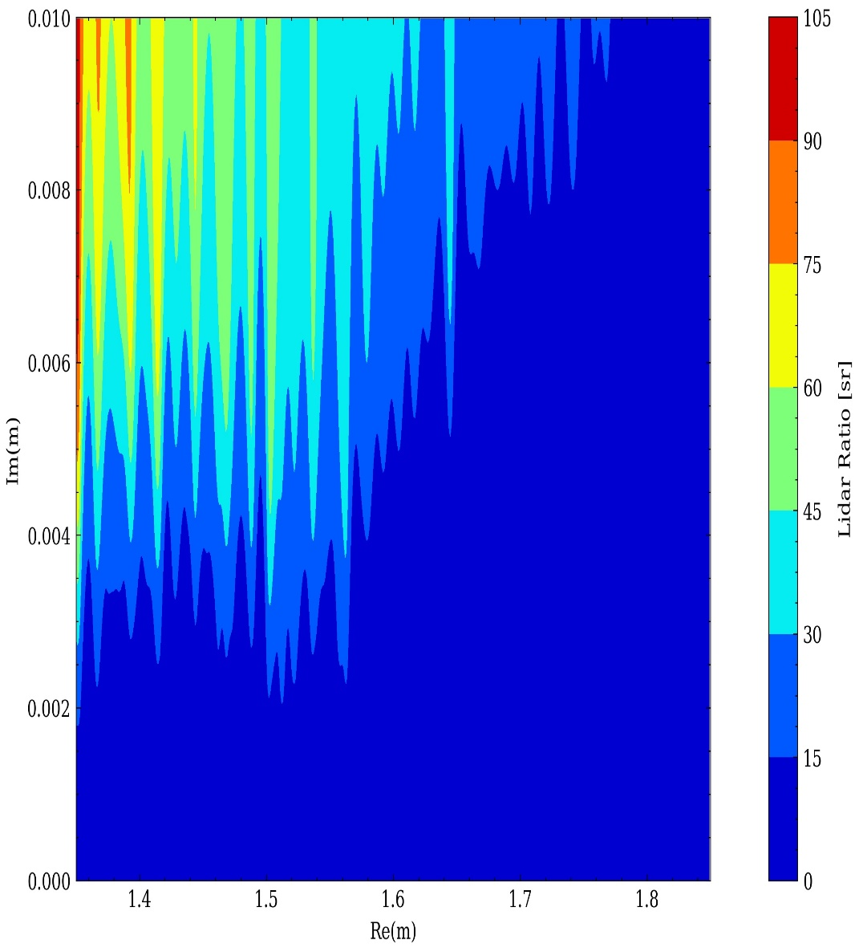
Sensitive test

Slide 10
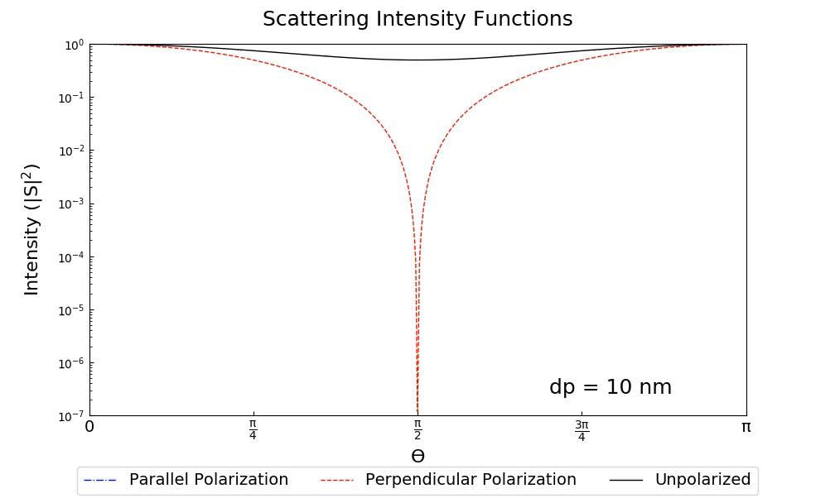
Video

Slide 11
Open question
Did I do something wrong for this work or I miss something for that ?

Slide 12
